Slide 1
Data Structure
Introduction
2022 / Spring

Slide 2
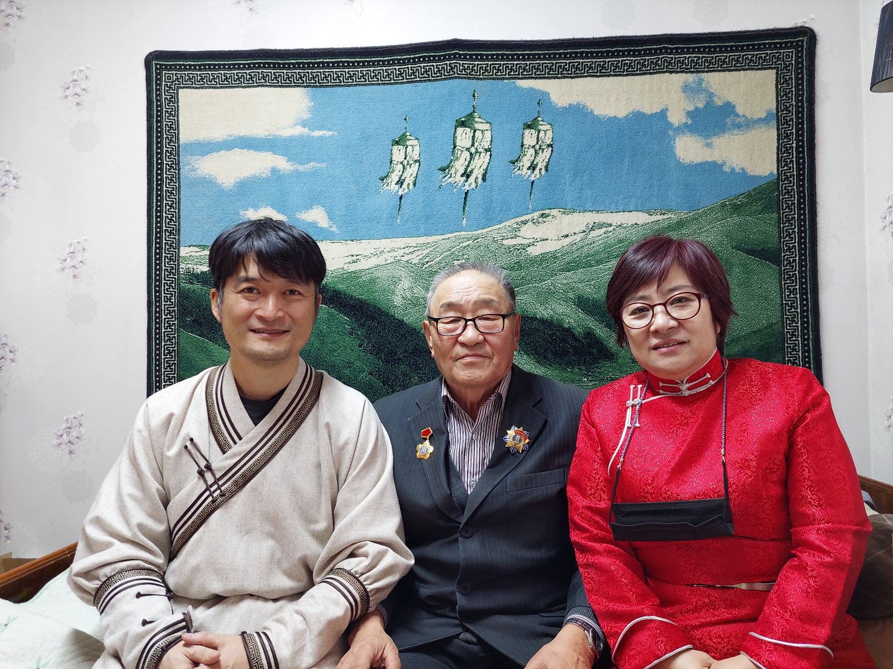
Professor
Kwangcheol Shin
kcshin@huree.edu.mn

Slide 3
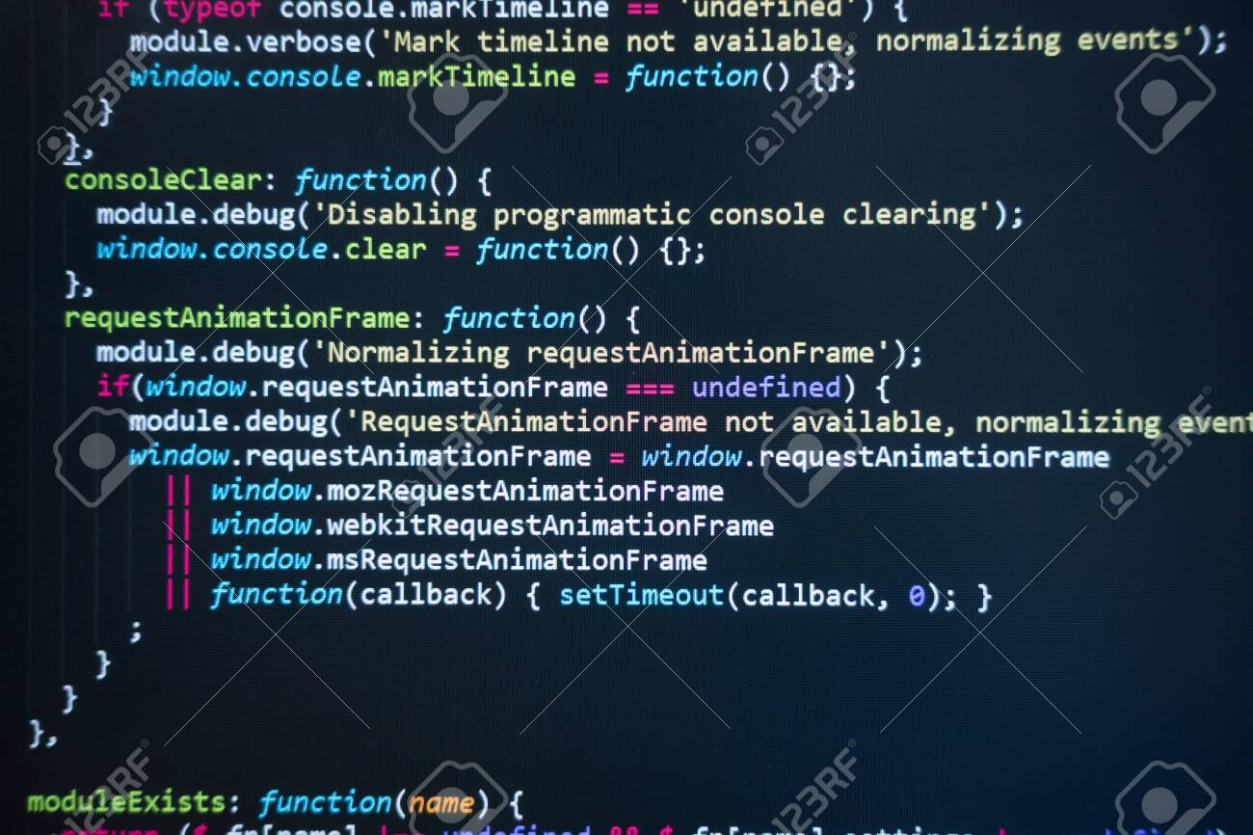
What is a Program?

Slide 4



Computer Program
Procedure for solving a problem with a computer.

Slide 5

Example of Problem
Summation Problem
1+2+3+…+N=?

Slide 6
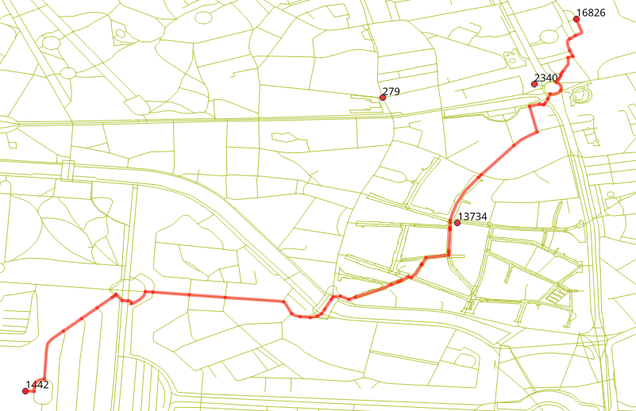
Shortest Path Problem

Slide 7
How to solve a problem with a computer?
We need to write a program.
You must think two things to solve a problem.
How to represent the problem? / Асуудлыг хэрхэн илэрхийлэх вэ?
➔ Data Structure
What process do you have to go through to solve the problem? / Асуудлыг шийдэхийн тулд ямар процессыг туулах вэ?
➔ Algorithm

Slide 8
Program = Data Structure + Algorithm

Slide 9
Data Structure
Data structure is a specific way to store and organize data in a computer's memory so that these data can be used efficiently later.

Slide 10
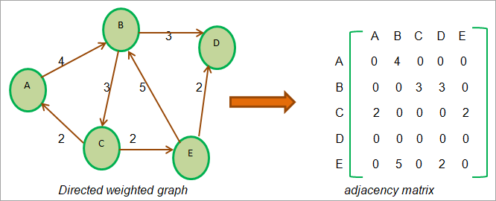
Example of Problem
Find the Shortest Path

Slide 11
Data Structure for Shortest Path

Slide 12
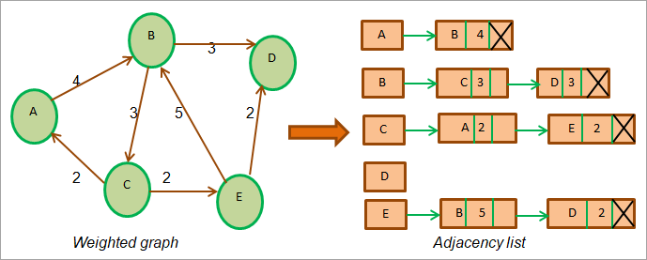
Асуудлыг илэрхийлэх олон янзын арга байдаг.

Slide 13
Algorithm
A set of steps that are followed in order to solve a problem / Асуудлыг шийдвэрлэхийн тулд дагаж мөрдөх алхамуудын багц
Асуудлыг шийдэх хэд хэдэн арга байж болно.

Slide 14
Summation Program in C
int summation(int n)
{
int i;
int sum=0;
for(i=1;i<=n;i++) {
sum=sum+i;
}
return sum;
}
Data Structure
Algorithm

Slide 15
Summation Program in C
int summation(int n)
{
int i;
int sum=0;
sum=n*(n+1)/2
return sum;
}
Data Structure
Algorithm

Slide 16
Program = Data Structure + Algorithm

Slide 17
Good Data Structure
1. It must reflect the actual relationships of the data with the real world object. / Энэ нь бодит ертөнцийн объекттой өгөгдлийн бодит харилцааг тусгасан байх ёстой.
2. The formation should be simple enough so that anyone can efficiently process the data each time it is necessary. / Бүрэлдэхүүн нь хангалттай энгийн байх ёстой бөгөөд ингэснээр хүн бүр шаардлагатай үед өгөгдлийг үр дүнтэй боловсруулах боломжтой болно.

Slide 18
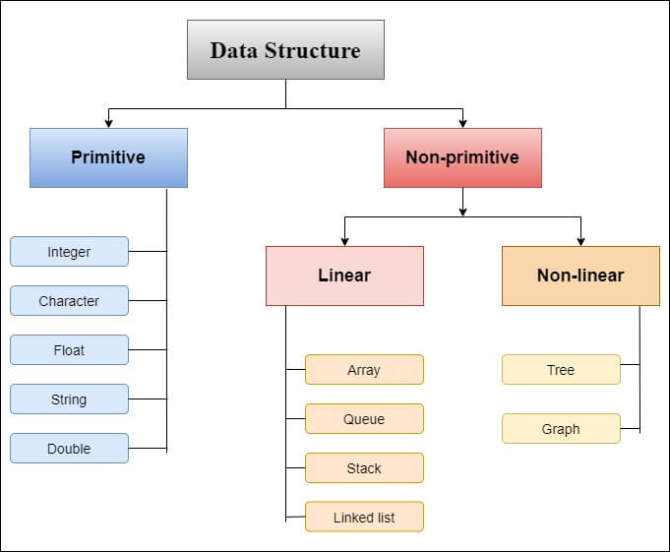
A primitive type is predefined by the language
Анхдагч төрлийг хэлээр урьдчилан тодорхойлсон
Non-primitive data types are created by the programmer

Slide 19
What we learn from this course?
Array
Stack
Queue
Linked List
Binary Tree
Heap
With Programming Language ‘C’

Slide 20
Grading Policy
Mid-Term Exam 30%
Final Exam 30%
Report 30%
Attendance 10%
If you don’t take mid-term or final exam, you will get F.

